Slide 1
Chapter 3 – Requirements Engineering
Anh Nguyen-Duc
Tho Quan Thanh

Slide 2
Topics covered
Functional and non-functional requirements
Requirements engineering processes
Requirements elicitation
Requirements specification
Requirements validation
Requirements change

Slide 3
Topics covered
Functional and non-functional requirements
Requirements engineering processes
Requirements elicitation
Requirements specification
Requirements validation
Requirements change

Slide 4
FUNCTIONAL & NON-FUNCTIONAL REQUIREMENTS

Slide 5
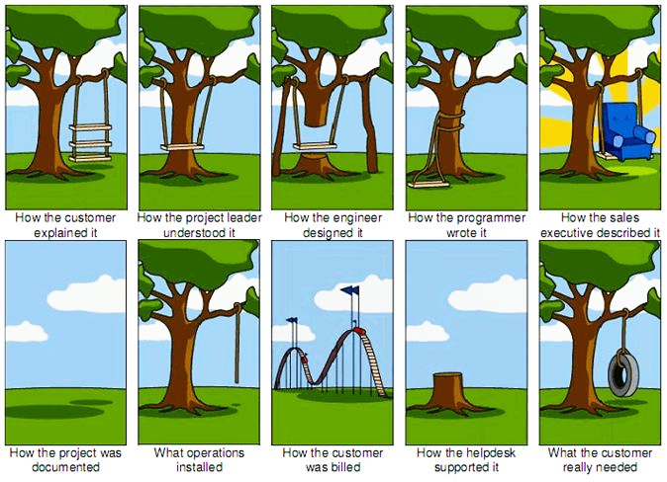

Slide 6
What is a requirement?
Requirement engineering = establishing the services that the customer requires from a system and the constraints under which it operates and is developed.
Requirement = the descriptions of
  the system services
  and constraints
It may range
  from a high-level abstract statement
  to a detailed mathematical functional specification.

Slide 7
Functional requirements
Statements of services the system should provide
How the system should react to particular inputs
How the system should behave in particular situations
State what the system should not do.
➔ Describe WHAT the system should do!

Slide 8
NON-Functional requirements
Not directly concerned with the specific services delivered by the system to its users.
Usually specify or constrain characteristics of the system as a whole.
➔ Describe HOW WELL the system can conform!

Slide 9
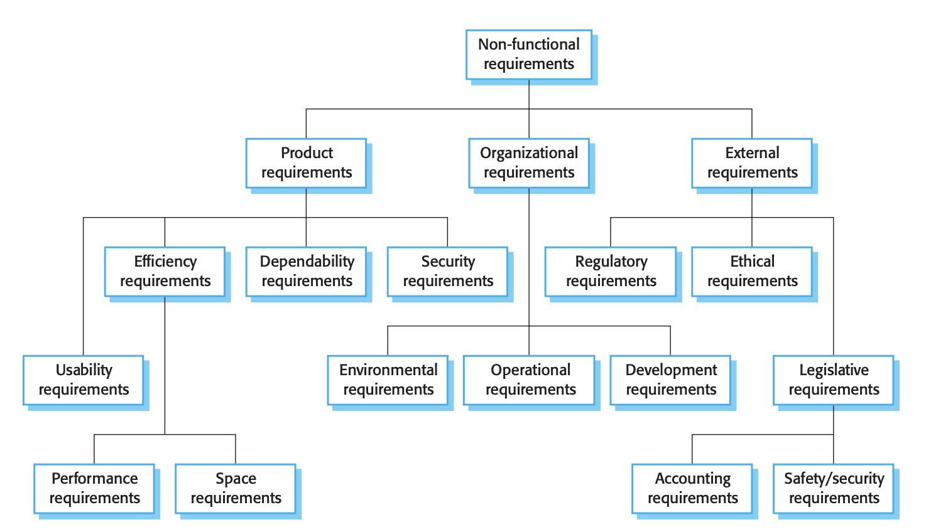
NON-Functional requirements

Slide 10
Goals vs. requirements
Goal
  A general intention of the user.
  Usually high-level and describe the desired end result of a project
  Often less volatile
Requirements are often
  Concrete
  Measureable
  Testable

Slide 11
Goals vs. requirements (cont.)
Goal:
The system should be easy to use by medical staff.
Non-functional requirement:
Medical staff shall be able to use all the system functions after four hours of training.

Slide 12
Non-functional requirements
Define system properties and constraints
  Properties: reliability, response time and storage requirements.
  Constraints: I/O device capability, system representations, etc.
Non-functional requirements may be more critical than functional requirements.
  If these are not met, the system may be useless.

Slide 13
System stakeholders
Any person or organization who is affected by the system in some way and so who has a legitimate interest
Stakeholder types
  End users
  System managers
  System owners
  External stakeholders

Slide 14
Topics covered
Functional and non-functional requirements
Requirements engineering processes
Requirements elicitation
Requirements specification
Requirements validation
Requirements change

Slide 15
REQUIREMENTS ENGINEERING PROCESSES

Slide 16
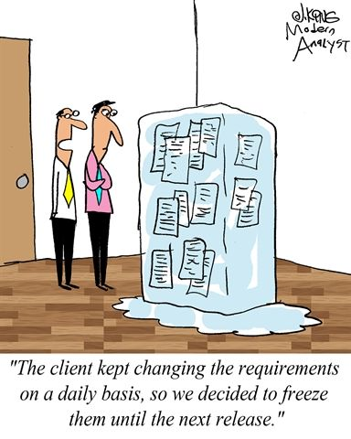
Requirements engineering processes
Processes to “generate” all requirements
Generic activities common to all processes
  Requirements elicitation;
  Requirements specification;
  Requirements validation.
In practice, RE is an iterative activity

Slide 17
A spiral view of the process

Slide 18
Topics covered
Functional and non-functional requirements
Requirements engineering processes
Requirements elicitation
Requirements specification
Requirements validation
Requirements change

Slide 19
Requirements elicitation and analysis
~ requirements elicitation or requirements discovery.
Work with customers to find out:
  the application domain, the services and the operational constraints (system performance, hardware constraints, etc.).
May involve
  end-users, managers, engineers involved in maintenance, domain experts, trade unions, etc. These are called stakeholders.

Slide 20
Problems of requirements elicitation
Stakeholders don’t know what they really want.
Stakeholders express requirements in their own terms.
Different stakeholders may have conflicting requirements.
Organisational and political factors may influence the system requirements.
The requirements change during the analysis process.
  New stakeholders may emerge and the business environment change.

Slide 21
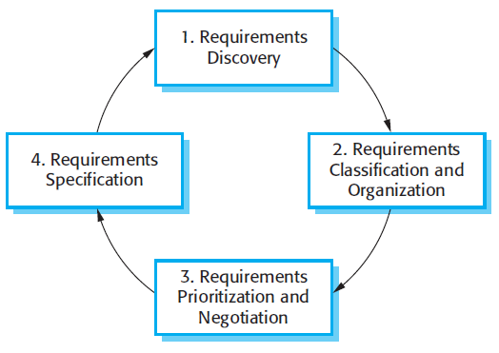
The requirements elicitation and analysis process
Interacting with stakeholders to discover their requirements.
Requirements are documented and input into the next round
Groups related requirements and organises them into coherent clusters
Prioritising requirements and resolving conflicts

Slide 22
Requirements discovery
To gather information about the required and existing systems and distil the user and system requirements from this information.
Main concerns:
  Stakeholders
  Discovery techniques/approaches/…

Slide 23

Discovery technique - Interviewing
Part of most RE processes.
Types of interview
  Closed vs Open => mixed?
Be effective
  Be open-minded, avoid pre-conceived ideas about the requirements and are willing to listen to stakeholders.
  Prompt the interviewee to get discussions going using a springboard question, a requirements proposal, or by working together on a prototype system.

Slide 24
Discovery technique - Ethnography
Observational technique
  used to understand operational processes and help derive support requirements for these processes
How
  A social scientist spends a considerable time observing and analysing how people actually work.
  People do not have to explain or articulate their work.
  Social and organisational factors of importance may be observed.

Slide 25
Topics covered
Functional and non-functional requirements
Requirements engineering processes
Requirements elicitation
Requirements specification
Requirements validation
Requirements change

Slide 26
Requirements specification

Slide 27
Requirements specification
The process of writing down the user and system requirements in a requirements document.
Notes:
  User requirements have to be understandable by end-users and customers who do not have a technical background.
  System requirements are more detailed requirements and may include more technical information.
  The requirements may be part of a contract for the system development

Slide 28
Ways of writing a system requirements specification
Notation | Description
Natural language | Sentences in natural language. Each sentence should express one requirement.
Structured natural language | Natural language statements on a standard form or template
Design description languages | Uses a language like a programming language, but with more abstract features
Graphical notations | Graphical models, supplemented by text annotations (best for functional requirements); UML use case and sequence diagrams are commonly used.
Mathematical specifications | Based on mathematical concepts such as finite-state machines or sets; Can reduce the ambiguity but hard to understand (and hard to check manually)

Slide 29
Ways of writing a system requirements specification
Notation | Description
Natural language | Sentences in natural language. Each sentence should express one requirement.
Waste collection is often designated to an organization that provides professional waste management services. A typical waste collection process involves (1) back officers, who operate a central system to create calendar, coordinate front collectors and janitors ,(2) collectors, who drive different types of vehicles and (3) janitors who manually collect garbage from Major Collecting Points (MCPs). Calendar and tasks were assigned among teams of janitors and coordinated by back officers. These assignments are often arranged in a weekly basic. Back officers also plan which vehicles to use and their routes. This planning activity happens every month. Everyday, the back officers sent messages with information about collecting route and time to collectors and janitors. Janitors use trollers (see Figure 1b) to collect garbage in their assigned areas and deliver to the MCPs. Collectors will pick up garbage from all janitors at an MCP. One collector drives only one vehicle during his working shift. The collector will drive through several MCPs with a predetermined route by back officers.

Slide 30
Ways of writing a system requirements specification
Notation | Description
Natural language | Sentences in natural language. Each sentence should express one requirement.
Used for writing requirements because it is expressive, intuitive and universal.
  The requirements can be understood by users and customers.
Problems
  Lack of clarity: Precision is difficult without making the document difficult to read.
  Requirements confusion: Functional and non-functional requirements tend to be mixed-up.
  Requirements amalgamation: Several different requirements may be expressed together.

Slide 31
Structured specifications
Notation | Description
Structured natural language | Natural language statements on a standard form or template
Writing on a standard form or template:
  Name
  Inputs, outputs
  The information needed for the computation
  Action
  Pre and post conditions (if appropriate)
  The side effects (if any)
Writing in a boiler plate template

Slide 32
Insulin Pump/Control Software/SRS/3.3.2
Function | Compute insulin dose: safe sugar level
Description | Computes the dose of insulin to be delivered when the current measured sugar level is in the safe zone between 3 and 7 units.
Inputs | Current sugar reading (r2); the previous two readings (r0 and r1).
Source | Current sugar reading from sensor. Other readings from memory.
Outputs | CompDose—the dose in insulin to be delivered
Destination | Main control loop.
Action | CompDose is zero if the sugar level is stable or falling or if the level is increasing but the rate of increase is decreasing. If the level is increasing and the rate of increase is increasing, then CompDose is computed by dividing the difference between the current sugar level and the previous level by 4 and rounding the result. If the result, is rounded to zero then CompDose is set to the minimum dose that can be delivered.
Requirements | Two previous readings so that the rate of change of sugar level can be computed
Pre-condition | The insulin reservoir contains at least the maximum allowed single dose of insulin.
Post-condition | r0 is replaced by r1 then r1 is replaced by r2.
Side effects | None

Slide 33
Tabular specification
Particularly useful when you have to define a number of possible alternative courses of action.
Example:
Condition | Action
Sugar level falling (r2 < r1) | CompDose = 0
Sugar level stable (r2 = r1) | CompDose = 0
Sugar level increasing and rate of increase decreasing ((r2 – r1) < (r1 – r0)) | CompDose = 0
Sugar level increasing and rate of increase stable or increasing ((r2 – r1) ≥ (r1 – r0)) | CompDose = round ((r2 – r1)/4) If rounded result = 0 then CompDose = MinimumDose

Slide 34
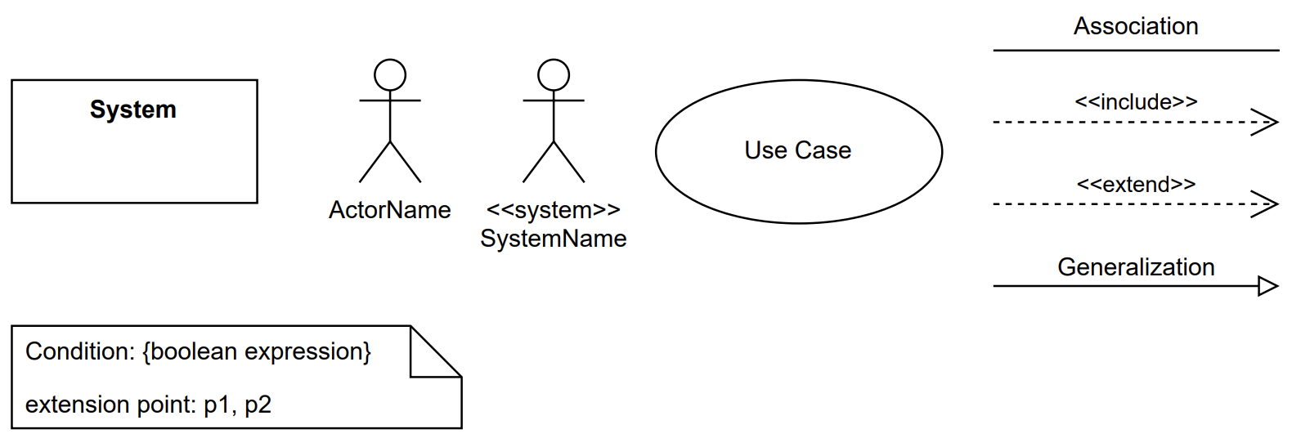
Use-case diagram
Figure 1: Main components of a use-case diagram

Slide 35
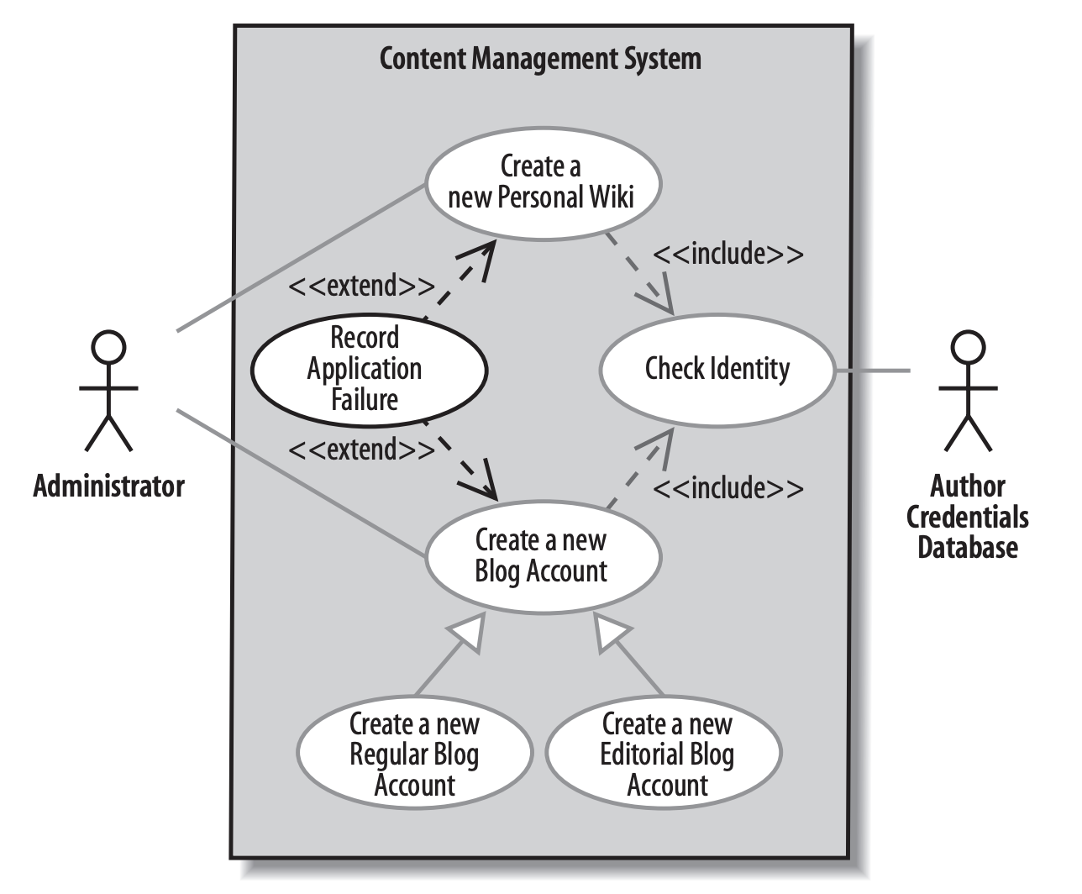
Use-case diagram
Figure 2: Simple use-case diagram for CMS

Slide 36
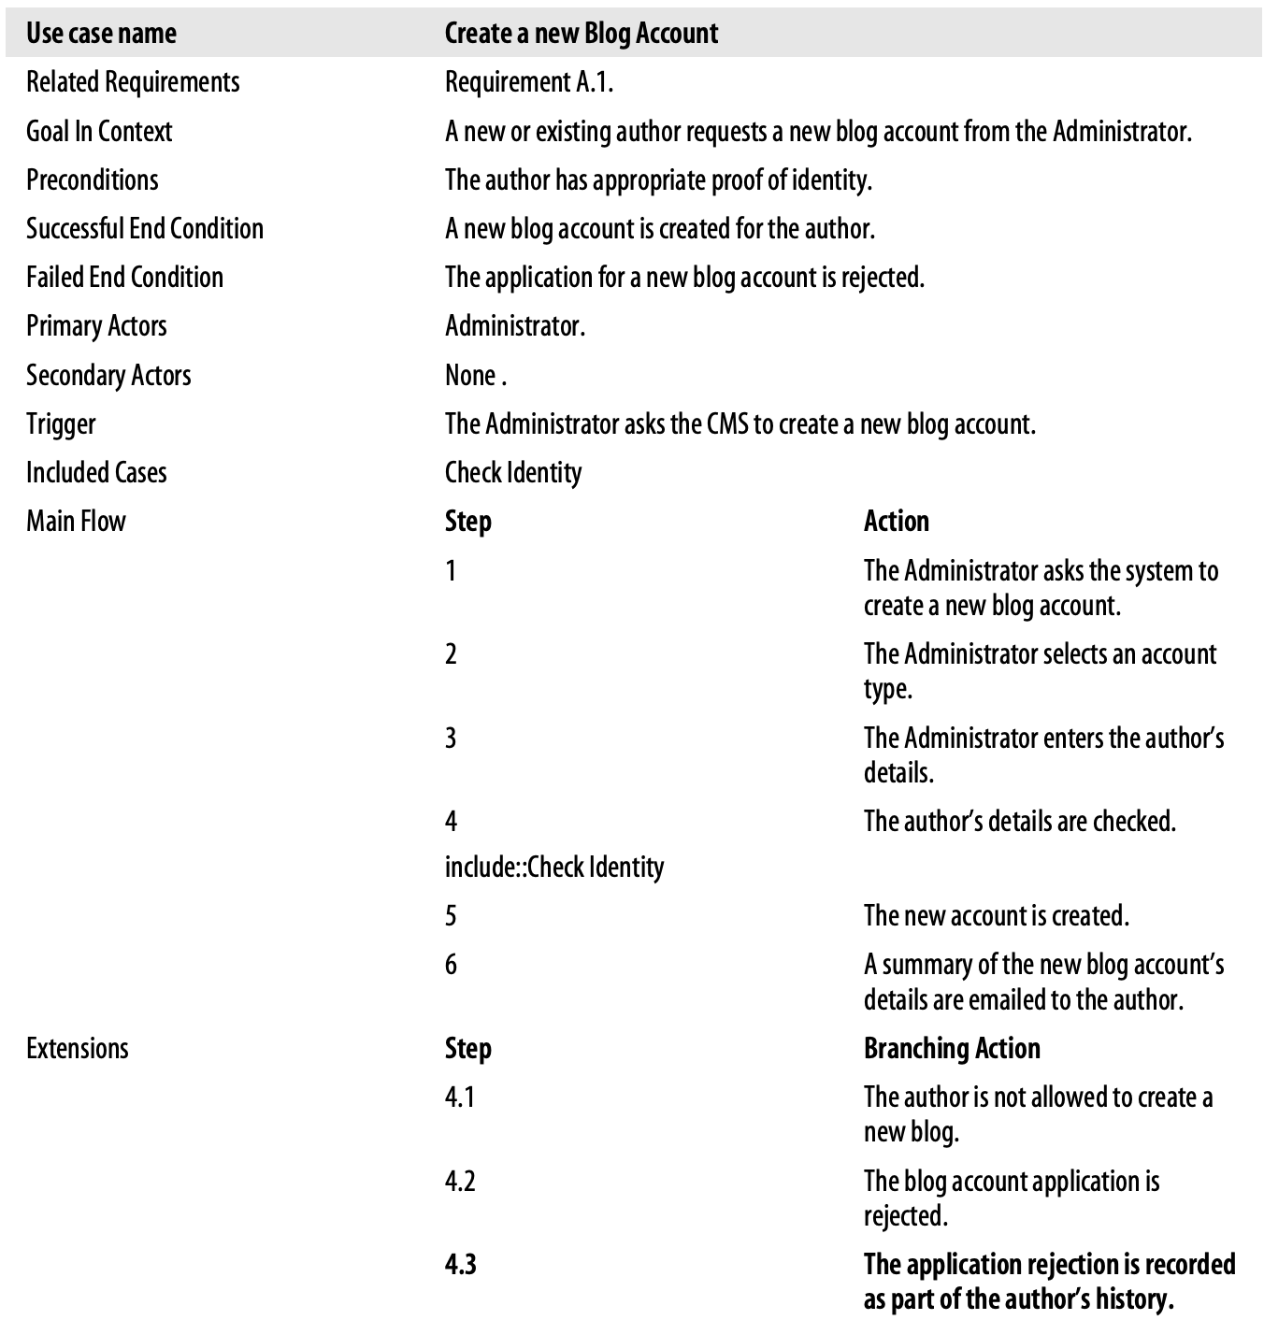
USE-CASE DESCRIPTION
Figure 3: Use-case description table for “Create a new Blog Account”

Slide 37


Slide 38
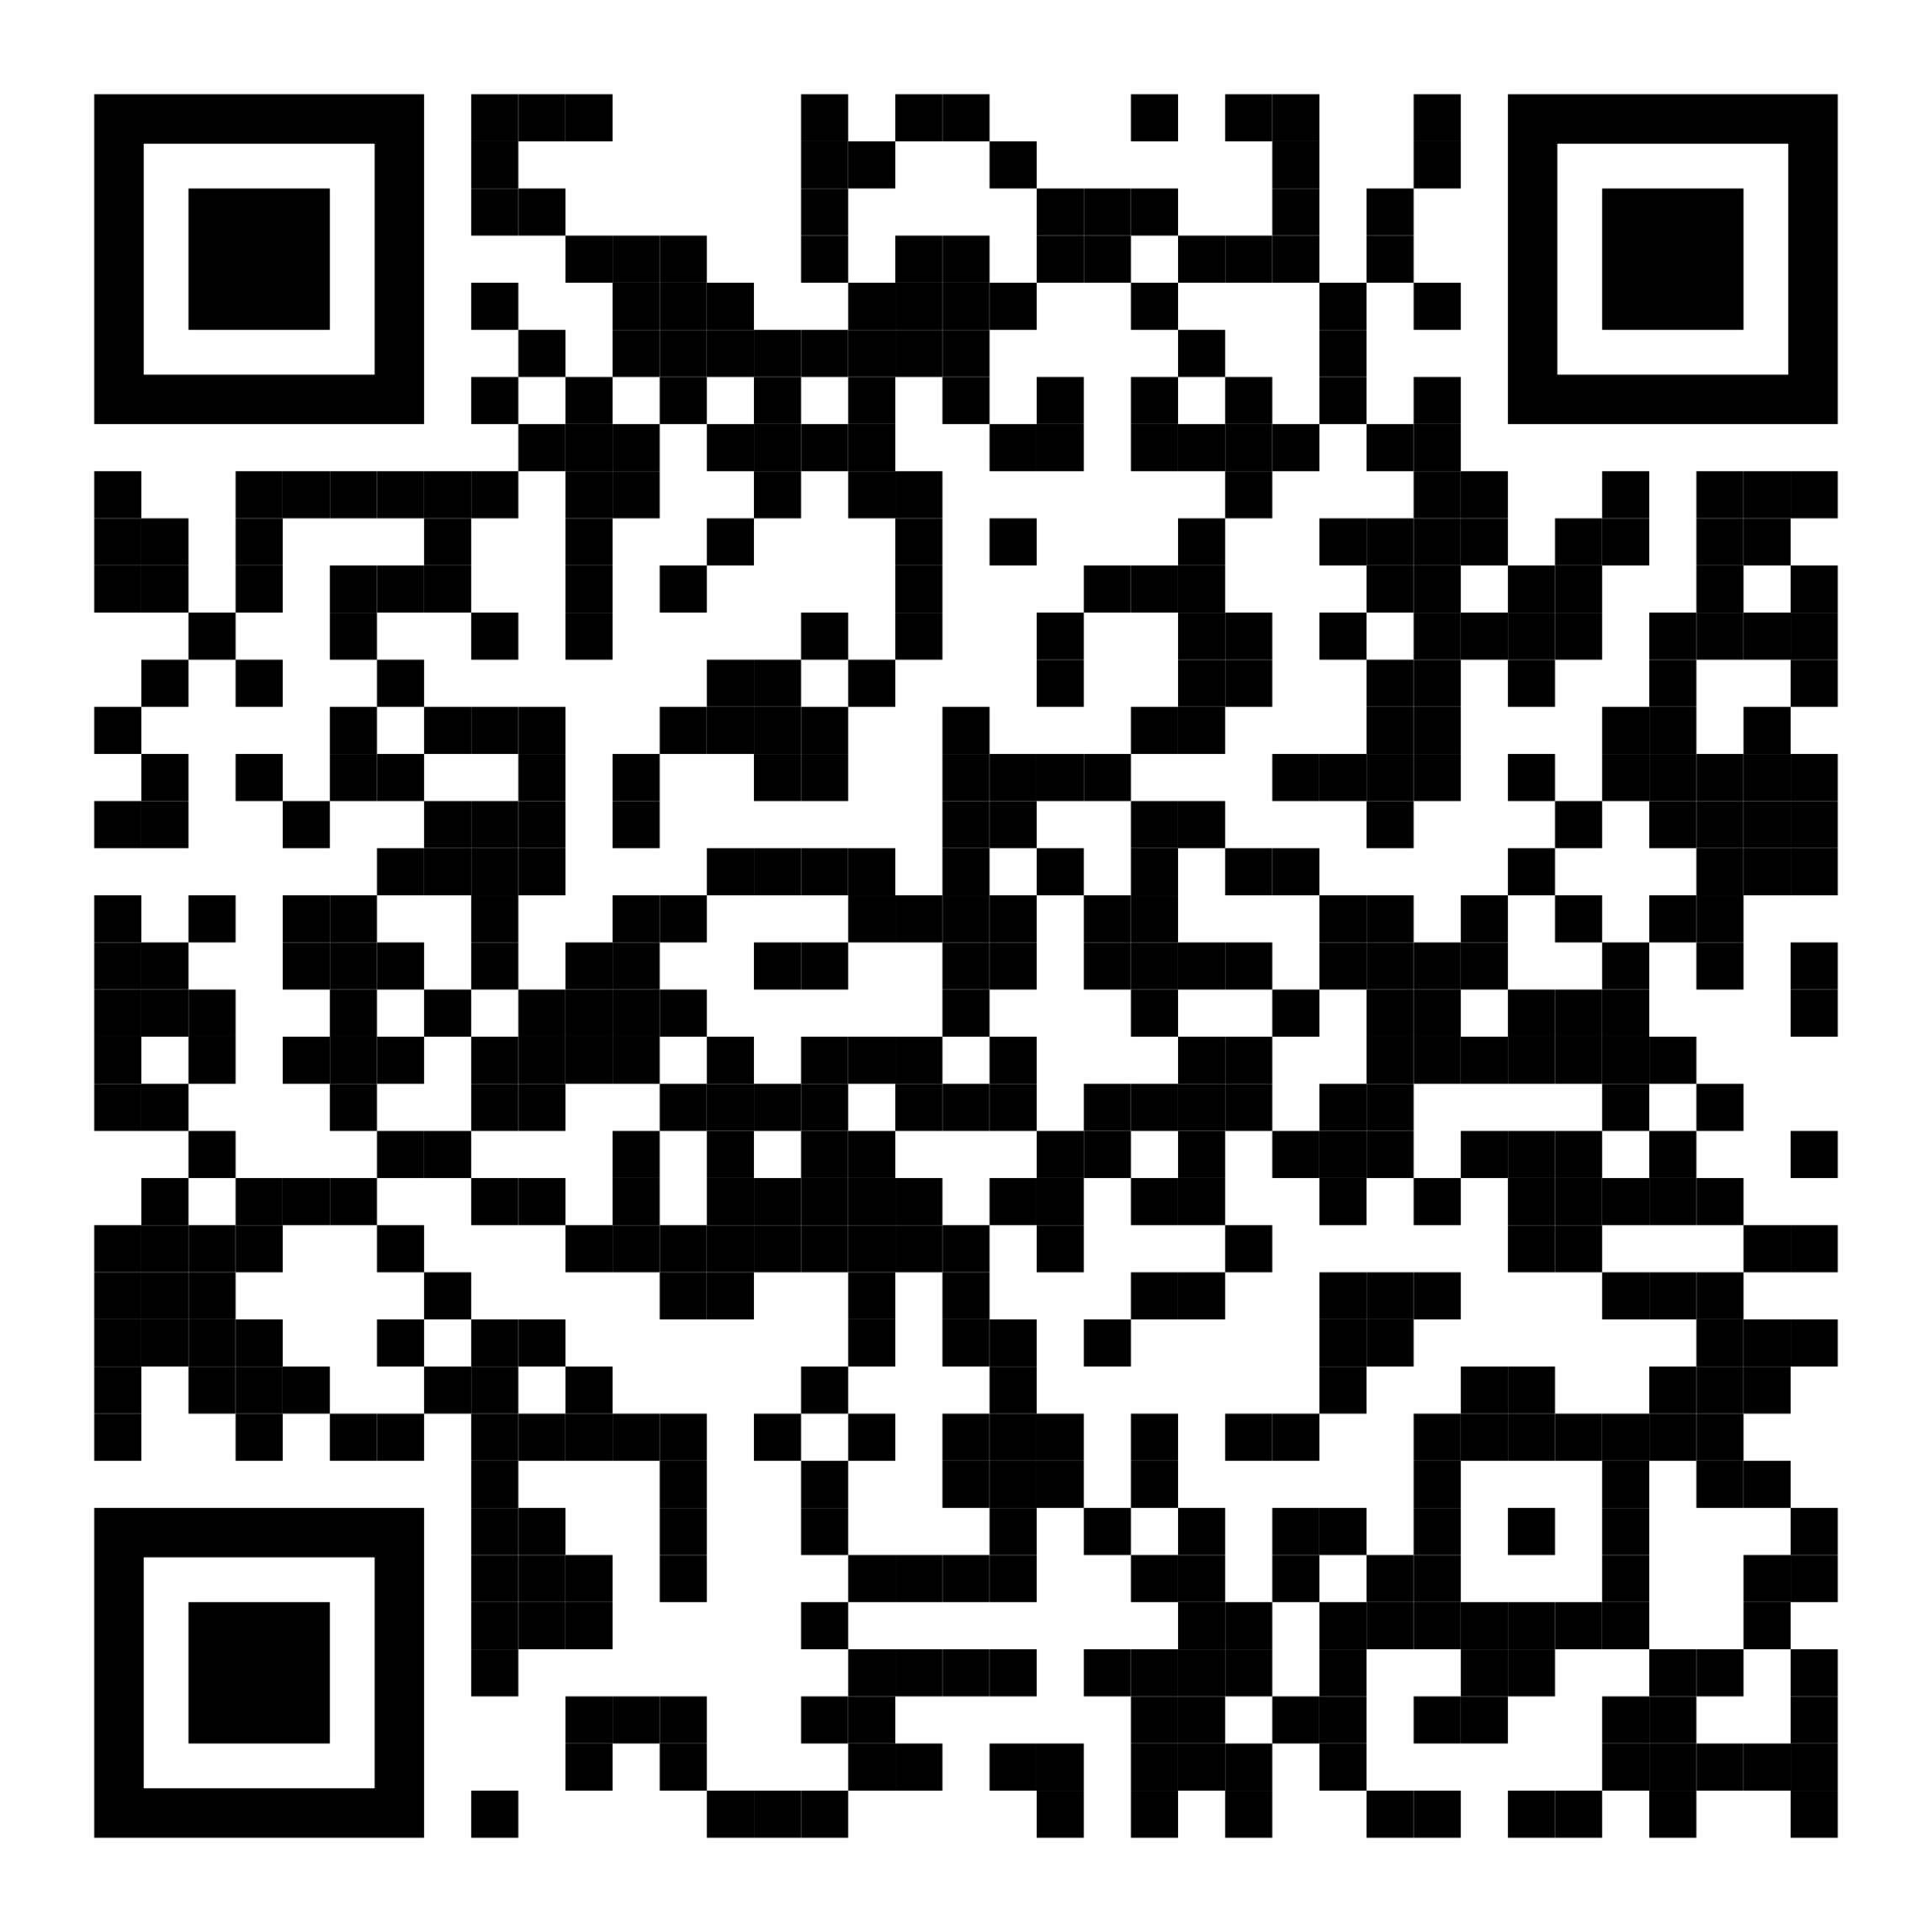
COMMON MISTAKES

Slide 39
Agile methods and requirements
Many Agile methods argue that producing detailed system requirements is a waste of time as requirements change so quickly.
The requirements document is therefore always out of date.
Agile methods usually use incremental requirements engineering and may express requirements as ‘user stories’
This is practical for business systems but problematic for systems that require pre-delivery analysis (e.g. critical systems) or systems developed by several teams.

Slide 40
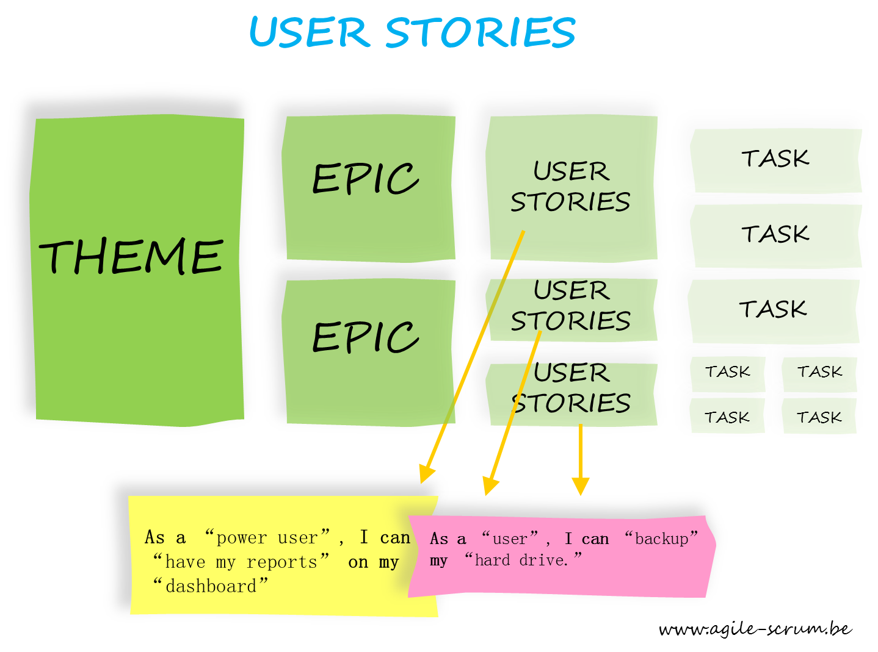
USER STORY
As a <type of user>, I want <some goal> so that <some reason>

Slide 41
Example
”As a returning customer, I want to log in with my fingerprint so that I can access my account quickly without typing a password.”
FR-1: The system must prompt the user for biometrics if a fingerprint template exists.
FR-2: The system must encrypt the biometric data token during transit.
FR-3: The system must redirect the user to the dashboard upon successful authentication.
FR-4: The system must display an "Authentication Failed" error after three unsuccessful attempts.
FR-5: The system must fall back to standard password entry if the biometric scanner fails.

Slide 42
Topics covered
Functional and non-functional requirements
Requirements engineering processes
Requirements elicitation
Requirements specification
Requirements validation
Requirements change

Slide 43
Requirements validation

Slide 44
Requirements checking
Validity.
  Does the system provide the functions which best support the customer’s needs?
Consistency.
  Are there any requirements conflicts?
Completeness.
  Are all functions required by the customer included?
Realism.
  Can the requirements be implemented given available budget and technology
Verifiability.
  Can the requirements be checked?

Slide 45
Requirements validation techniques
Requirements reviews
  Systematic manual analysis of the requirements.
Prototyping
  Using an executable model of the system to check requirements.
Test-case generation
  Developing tests for requirements to check testability.

Slide 46
Topics covered
Course’s project
Functional and non-functional requirements
Requirements engineering processes
Requirements elicitation
Quality of requirements
Requirements specification
Requirement in Agile
Requirements validation
Requirements change

Slide 47
Requirements change

Slide 48
Changing requirements
The business and technical environment of the system always changes after installation.
The people who pay for a system and the users of that system are rarely the same people.
Large systems usually have a diverse user community, with many users having different requirements and priorities that may be conflicting or contradictory.

Slide 49
Requirements management
Requirements management is the process of managing changing requirements during the requirements engineering process and system development.
New requirements emerge as a system is being developed and after it has gone into use.
You need to keep track of individual requirements and maintain links between dependent requirements so that you can assess the impact of requirements changes. You need to establish a formal process for making change proposals and linking these to system requirements.

Slide 50
Requirements management planning
Establishes the level of requirements management detail that is required.
Requirements management decisions:
  Requirements identification
  A change management process
  Traceability policies
  Tool support

Slide 51
Requirements change management
Deciding if a requirements change should be accepted
  Problem analysis and change specification
  Change analysis and costing
  Change implementation

Slide 52
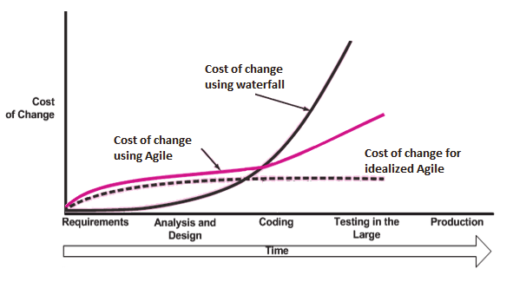
Response to change: AGILE approach!

Slide 53
Summary
Requirements: what the system should do and constraints on its operation and implementation.
Functional requirements = the services
Non-functional requirements = constraints (development & use)
  apply to the system as a whole.
The software requirements document (i.e. SRS) is an agreed statement of the system requirements.
The RE process is an iterative process
  requirements elicitation, specification and validation.

Slide 54
Summary (cont.)
Requirements elicitation and analysis = iterative process
  requirements discovery, classification and organization, negotiation and requirements documentation.
Techniques for requirements elicitation
  interviews, scenarios, use-cases and ethnography, etc.
Requirements validation = checking the requirements
  for validity, consistency, completeness, realism and verifiability.
Business, organizational and technical changes inevitably
  => changes to the requirements for a software system.
Requirements management = managing and controlling the requirement changes.

